Slide 1

Project 3 Application Business Idea
Group 3:
Jiang Guanlin, Huang Tianji, Hong Yuling, Lau Choi Yu, Lam Wan Yuet, Yang Xiao Lin, Lam Ho Yan

Slide 2
page. 10
Problem Identified
& Solution
01.
Problem1 solution
- After you take a picture in the app, the text box is provided to record when and where the picture was taken. The photo will be saved in the app with the location and time it was taken.
- Manual input by the user increases the accuracy of the information.
Problem 1
Place & Time :
Time Memories Imager
Can't remember exactly when and where every photo was taken
02.
Problem 2
Sharing context :
Problem2 solution
Hardly shared with others along with pictures’ location
- The app provides sharing service that shares photos along with time and place to others on the platform of the user's choice.
Hardly shared with others along with pictures’ details.
Group3

Slide 3
Business Model
Product
An app with camera and memoir aims to record time and place which the photos were taken and assemble into a gallery.
Target Market
From customer:
Charged for advanced functions
Pay for limited-time special designed decorations
The fee based on times to attract the potential customers to purchase the monthly plan
From copartner:
Sponsor - Offline activities

Slide 4
Basic Function​ ​ | Make the Photo Timeline and video​ | Cloud Storage (Compress) + Timeline Video​ ​ | Cloud Storage (Original image) + Timeline Video​ ​
Free​ ​ | 10 HKD / time​ ​ | 20 HKD / Month​ ​ | 40 HKD / Month​ ​
AD​ | No AD​ | No AD​ | No AD​
Revenue From Application

Slide 5

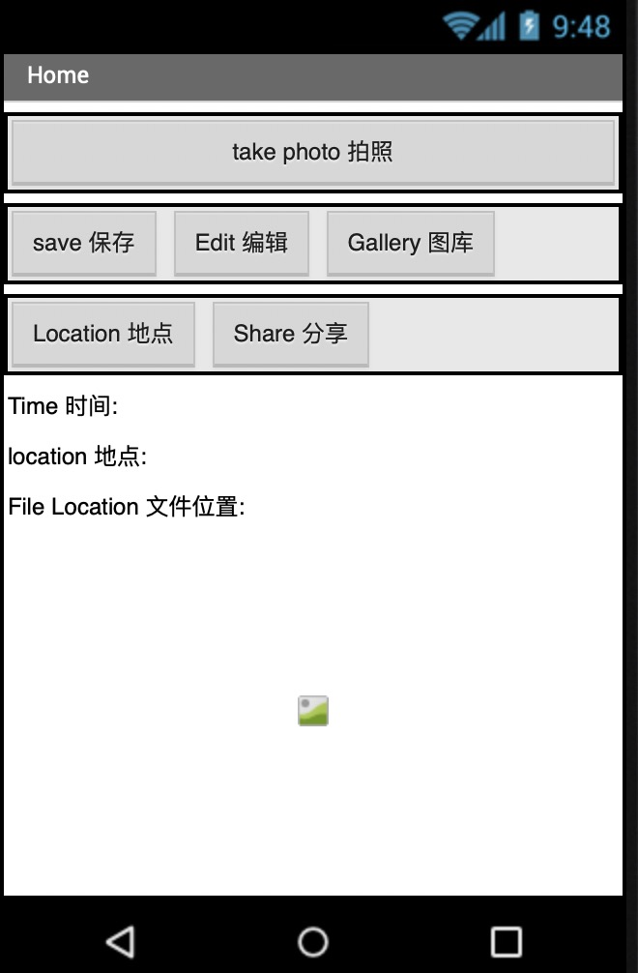
Underlying Magic/Technology
Record time and location
use TinyDB to store the details of the photos and call it when the users choose that photos.

Slide 6
Marketing and Sales
Explore customers: Assume 1 million customers attracted by our advertisements
Operation Cost: 1 million HK dollars are set for the cost of retaining new customers
Confidence: 1. Cooperation made with local artists and animation production companies
-limited-time special designed decorations
2. Offline activities( Download our APP for free check-in with animation characters )
Market Plan Efficiency: depends on downloads and revenues

Slide 7
Our Competitors
 | Simple Gallery | A+ Gallery | Timeline Memories Imager
Price | Free | $7 | Free Additional payment for advanced functions
Functions | Basic functions only | Basic functions Advanced functions | Basic functions Advanced functions

Slide 8
Team
Time
Memories
Imager
Founder : Nirvana Rebirth
Time
Memories
Imager
A professional team which made up of different experts
Time
Memories
Imager
Get more updated information from our website

Slide 9

Projection and Milestones
We are a promising investment:
1. Multiple source of revenue
-Advertisement in app, subscription free
2. Low operation cost
How to measure our growth:
1. Amounts of subscribers of our app
2. Advertising volume in the app
Our first target:
1. Having 10000 subscriber by 2021

Slide 10
Status and Timeline
List on Growth Enterprise Market
(2025)
Raise our market share in to 50%
BY
2025
200 million market value

Slide 11
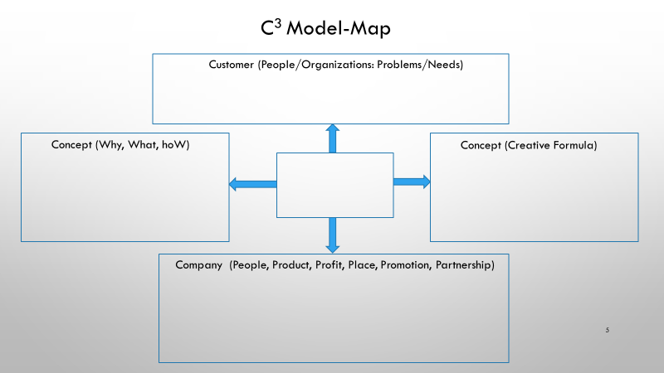

Customer: People who like to take pictures or share their own photos
Problem: Easy to forget details about photos
Need: To record the details about photos and share with others
Why: A sense of nostalgia, only short memories are stored in the brain, to record memories by technology
What: An app to record memories at that moment, that place and share with others
How: Using a lot of functions to make a memoirs and share with others
Time Memories Imager
Camera✖️Gallery✖️Internet
People: Nirvana Rebirth with experts in charge of different professions
Product: An app for saving and editing photos
Profit: Revenues from advertising and subscription
Place: APP stores and website
Promotion: Influencers, social media and trial period
Partnership: Local artists and Corporate with animation production companies
Notes:
Oliver

Slide 12
Thanks

